Slide 1


Revenue At Risk
WIDE WORLD IMPORTERS
Understand how sales performance has changed over time
Use that understanding to inform strategy
End with specific recommendations

Slide 2




How Sales Performance Has Changed Over Time
While overall sales metrics paint a picture of success, a deeper dive into monthly trends reveals significant volatility and concentrated growth areas.
Overall Sales Look Strong
But the deeper story appears in the trend
Total revenue: $55.82M
Monthly sales are volatile, not stable:
Over 23,000 orders processed
Sharp spikes in certain months
Consistent year-over-year increases
Noticeable dips in others
Growth is happening, but not predictably
What's driving the changes?
Geographic Concentration
Reliance on Top Performers
Stagnant Customer Base
75% of cities contribute heavily to revenue, creating an imbalanced sales landscape.
Sales reps carry most of the revenue, making overall performance vulnerable and over-dependent.
Customer base growth remains at 0%, hindering long-term expansion and stability.
Sales didn't change randomly — they changed because cities, reps, and customers were moving differently, indicating underlying structural issues.

Slide 3

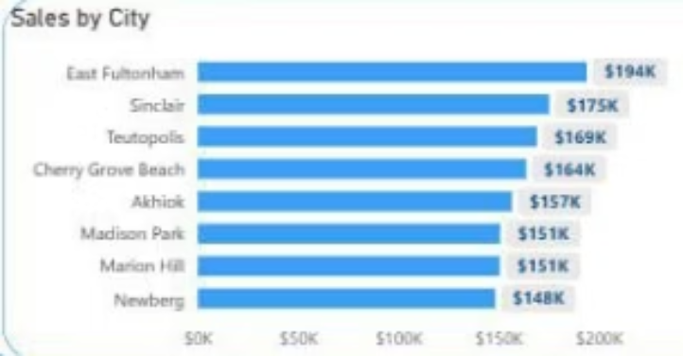
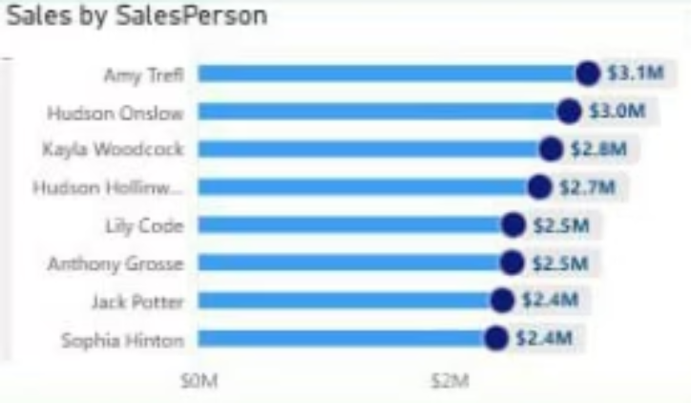
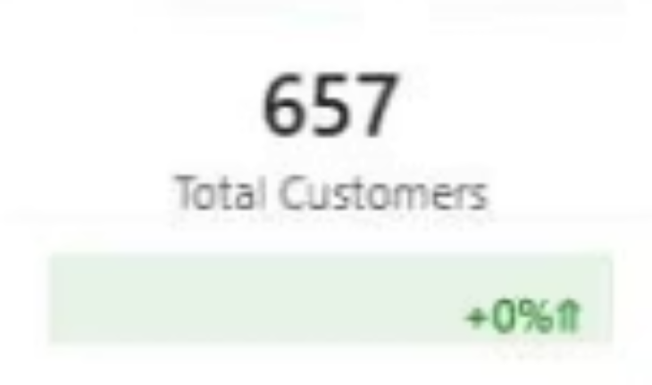
What This Means for Strategy
Understanding the current trends allows us to identify critical areas that require strategic intervention to ensure sustainable growth and stability.
1
2
3
Concentrated Growth
Fragile Sales Performance
Customer Stagnation
A handful of cities (e.g., East Fulton ham & Sinclair) carry the brand while others lag/contributed lesser, leading to unstable monthly performance.
Top reps drive strong momentum; mid-tier reps are under-optimized, making revenue strong but fragile.
With 657 customers and 0% growth, investigations show consistent fluctuations over the years, indicating that while lost customers have been retained, no new customers have been added. Expansion is limited, performance is uneven, and pressure on top regions and representatives is increasing.
So the strategy must focus on:
Broadening Reach
Strengthening Weak Areas
Increasing Consistency

Slide 4
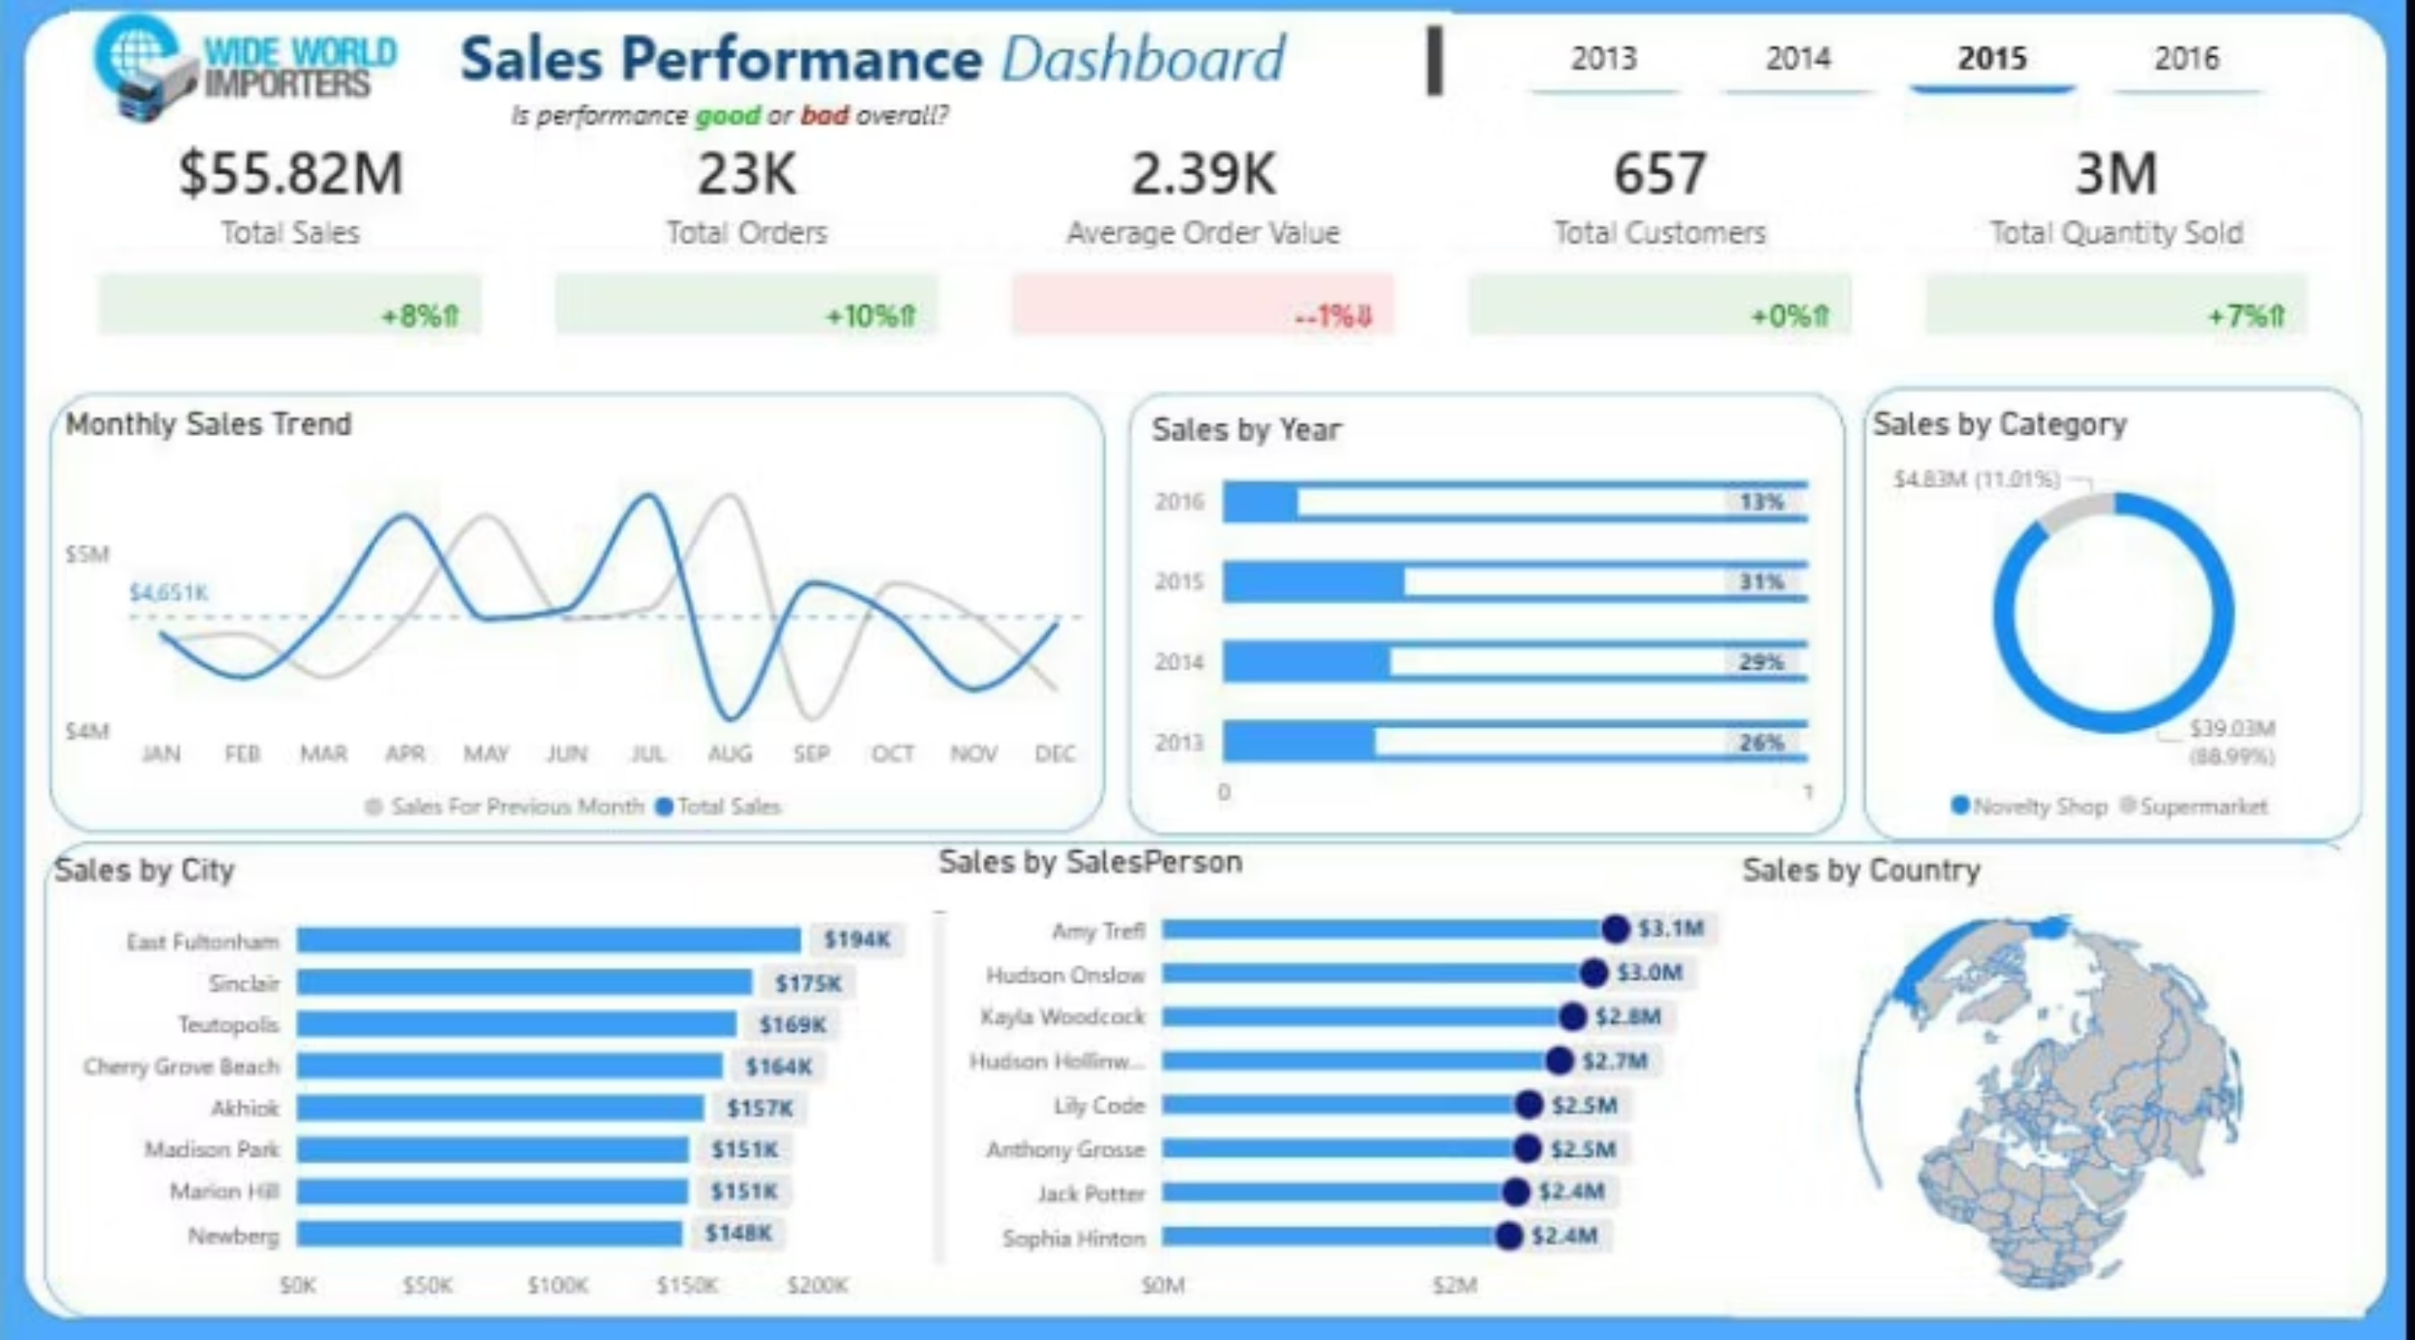
Wide World Importers — Sales Performance

Slide 5




Recommendations Prioritize Strategic Interventions
To address the identified challenges and unlock our full growth potential, we must focus on these key areas.
1
Customer Acquisition
2
Develop Underperforming Cities
0% growth is not sustainable.
Investigate why certain cities contribute lesser (e.g., pricing, product fit, low sales coverage).
Introduce targeted campaigns, partnerships, or geographic outreach to expand our customer base.
Moderate improvements here will help stabilize monthly performance across the board.
3
Strengthen Mid-Tier Reps
4
Reduce Monthly Volatility
Provide training, mentorship, and better territory assignments to our mid-tier sales force.
Review inventory timing, seasonality, and promotional planning.
This can unlock major additional revenue and reduce reliance on top performers.
Aim for smoother, more predictable performance throughout the year to ensure consistent revenue streams.

